Slide 1
Self Esteem & Advocacy
Stepping Stones To Mental Health
Notes:
Joint

Slide 2
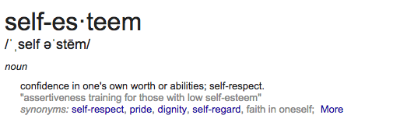
Self-Esteem
“You yourself, as much as anybody else, as much as anybody in the entire universe, deserve your love and attention.”
- Prince Gautama Siddhartha
Notes:
Abi
perception of yourself.

Slide 3
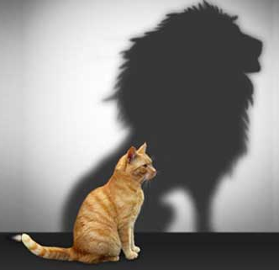
Self-Esteem
Self-Esteem is a combination of self-image, ideal self, and pygmalion-self.
Self Image: What we perceive ourselves to be.
Ideal-Self: How we want to be.
Pygmalion-Self: Our perception of what we believe other people think of us.
Self-Esteem will affect overall attitude, health, and choices you make.
https://www.youtube.com/watch?v=litXW91UauE
Notes:
Abi
Story: As a teenager, my self image began to deteriorate based on my perception of how others viewed me (pygmalion-self). It is likely similar for other adolescents: One negative comment would made me think that everyone else viewed me the same way.

Slide 4
Factors Influencing Development of Self-esteem
High Self-esteem | Low Self-esteem
Encourage challenges | Lack of choices/Not being allowed to choose
Having a trustworthy support system | Being expected to be perfect all the time
Healthy communication | Being ignored or ridiculed
Being spoken to respectfully | Experienced repetitive failure
Being praised | Experiencing trauma/abuse
Being listened to | Being criticized
Notes:
Abi
There are many factors that influence our self-esteem both positively and negatively.
Low self-esteem = being treated and spoken to in a negative way such as being criticized or ridiculed or abused.
High self-esteem = positive, healthy relationships where there is trust, communication and respect.

Slide 5
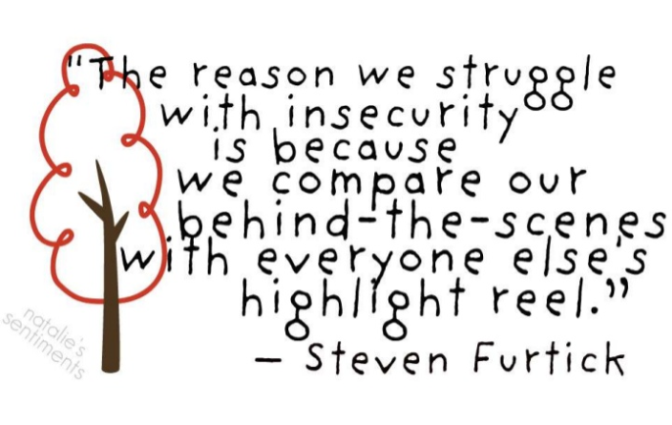
Other Factors Influencing Self Esteem
Some common factors that can affect our self esteem are:
Media:
https://www.youtube.com/watch?v=hibyAJOSW8U
Self Talk
Accomplishments
Expectations (Realistic vs. Unrealistic)
Attitude, Family, Friends, Peers
https://www.youtube.com/watch?v=Pqknd1ohhT4
Perceptions
https://www.youtube.com/watch?v=wyHYWXie-Mw
Notes:
Abi
There are other than factors impact us that do not only involve relationships and how we are treated.

Slide 6
Other Factors Influencing Self Esteem Contd
Notes:
Abi
In my university class of Community Research & Design in the Child Studies program, my partner and myself conducted a study regarding the impact of relationships on self-esteem. One of our questions in the survey was what influences an individual’s self-esteem: Past romantic relationships, current romantic relationships, peers, family, school or employment. As you can see, the majority of the individuals indicated that peers was the #1 influence on self-esteem.

Slide 7
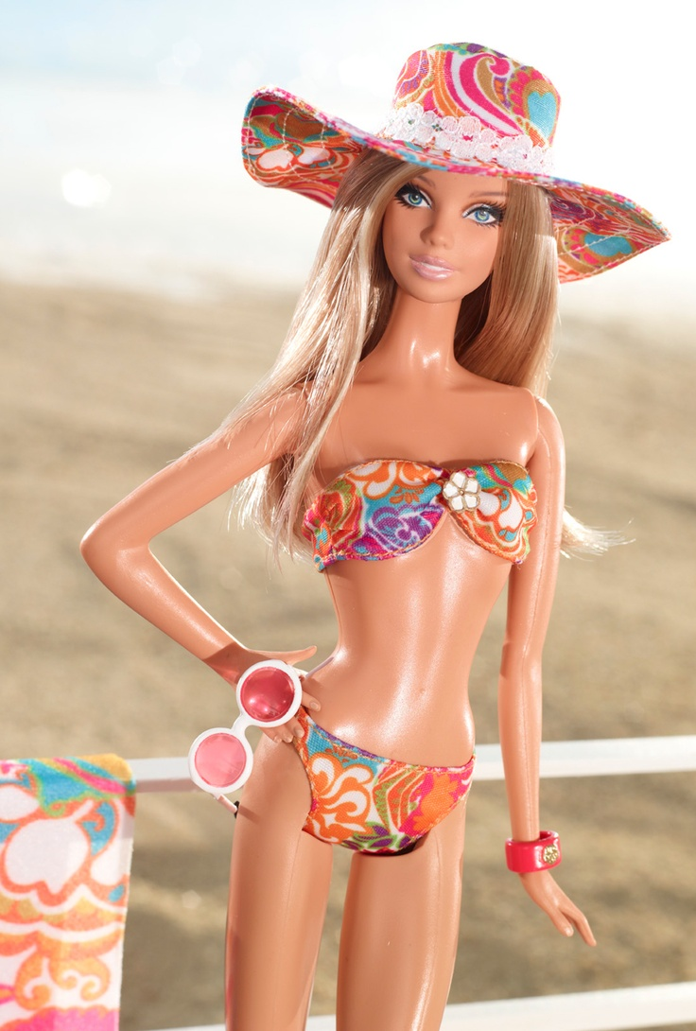
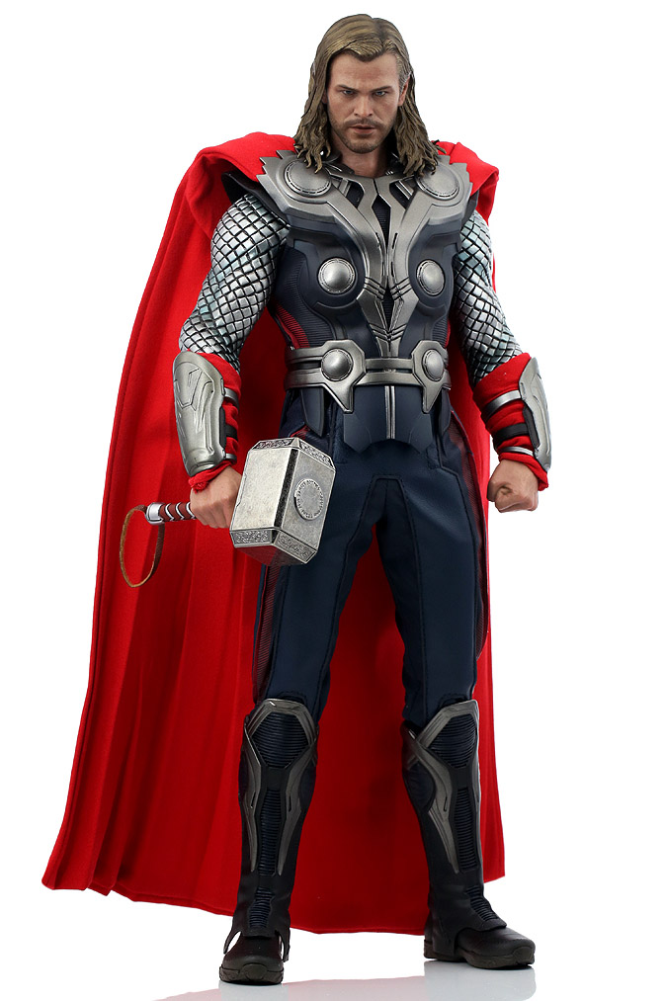
Social Pressures
Many social pressures are unrealistic
Media puts a huge emphasis on physical appearance:
The traditional example: Barbie for females, GI Joe for males
Social Expectations are constantly changing
Can anyone think of some that are prominent currently?
Social Expectations are not accurate
You are much more than the opinions of others.
Notes:
Ashley
Parental Social Expectations:
The “do it all parent”:
Fit
Eats proper
Works
Volunteers at the school
Bakes cookies for the classrooms
Makes time for friends
Successful and satisfying relationships
“Be Chill and Cool”
Sometimes expectations for students is similar!
Like and do well in all your classes
Be good at sports, and art
Be fit
Don’t be stressed

Slide 8
Potential Consequences of High Self-Esteem
Confidence
Sense of Optimism
Happiness
Organizational Prosperity
Good Mental Health
Benefits from negative feedback
Career success
Healthy relationships
Being able to advocate for oneself
Choices that reinforce high self esteem
Notes:
Ashley

Slide 9
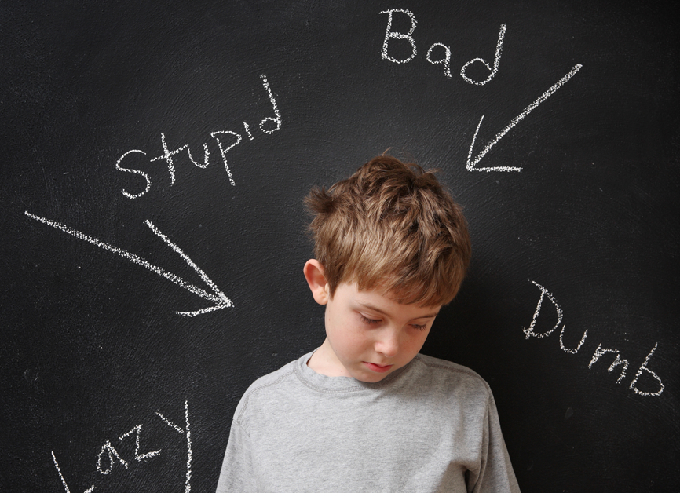
Potential Consequences of Low Self-Esteem
Choices that reinforce low self-esteem
Negative mental health
Unable to advocate for oneself
Unhealthy relationships
Insecurity
Unhappiness
Depression
Inner criticism
http://enlightenmentportal.com/wp-content/uploads/2015/01/High-vs-Low-Self-Esteem-Final.jpg
Notes:
Ashley
Work Example:
First year at the position, not feeling very comfortable with the position. Making choices that reinforced feeling lonely and isolated.

Slide 10
Tips on building self-esteem
Set goals and make action plans for the future
Take advantage of new learning experiences
Take care of your health (nutrition, exercise, sleep)
Practice assertiveness
Practice saying no without feeling guilty
Try new challenges and hobbies
Choose friends and partners who value and respect you
Replace negative self-talk with supportive self-talk (CBT)
Try to think positively
Align your actions with your values
Aim for small accomplishments, rather than perfection
Consider mistakes as learning opportunities
Notes:
Ashley:
One of the largest conversations we have with students is the “red thoughts/unhelpful thoughts” versus “green thoughts/helpful thoughts” conversation. We ask them to practice challenging those red/unhelpful thoughts, and to try to replace them with green/helpful thoughts. This is considered CBT (Cognitive Behavioural Therapy) style strategies.
“Neurons that fire together, wire together”
Celebrate little victories: Mom’s job example
Mistakes: WE ALL MAKE THEM: Try to be compassionate. What are you saying to yourself? What would you say to a friend in that situation? Is it different? Why?

Slide 11
Self Esteem & Self Advocacy
Our self esteem can influence our ability and approach to self advocacy.
Having low self esteem may make it difficult for us to be able to self advocate, while having high self esteem may make it easier for us to self advocate.
Students who gain and develop a greater understanding of their own needs gain confidence to recognize their abilities. This will allow students to set realistic goals for themselves. It is important to voice your opinion, address concerns as well as developing learning strategies for setting goals, time management and problem solving. In order to self-advocate, students need to RECOGNIZE, ACCEPT and UNDERSTAND.
Notes:
Abi
Being able to advocate for oneself is an important aspect of life. Self-esteem and self advocacy are intertwined and influence on another. Being provided with the skills/knowledge is also important.
Young people who know their strengths and be confident and competent in their abilities will be better able to self advocate.
RECOGNIZE: what they need
ACCEPT: responsibility
UNDERSTAND: how to advocate for themselves

Slide 12
Self-advocacy
“Asking for what you need, what you want and what you’re worth requires practice. So practice self-love and start asking.”
Ann Marie Houghtailing
Notes:
Abi
Ability to speak for oneself
Assertive - bridal shoot vs. wedding day photos story
Persistent
Articulating what you need.
Story from Ashley: Articulate: Maybe they need to write it out? Friend example, husband example.

Slide 13
Self-advocacy
Requires:
Self-confidence
Awareness of personal preferences, interests, strengths, and limitations
Ability to differentiate between wants and needs
Ability to consider multiple options and to anticipate consequences for decisions
Ability to initiate and take action when needed
Ability to evaluate decisions based on the outcomes of previous decisions and to revise future decisions accordingly
A striving for independence while recognizing interdependence with others
Ability to self-regulate behaviour
Independent performance and adjustment skills
Ability to use communication skills such as negotiation, compromise, and persuasion to reach goals
Creativity (such as creating other accommodations that help support the need of the students)
Notes:
Abi
Understand: is it a want or a need?
Perspective taking
Make a decision about what you want/need. Then ACT on it.
This can be done by talking to others to recognize the issue, identify the potential options, choose the best option, act.

Slide 14
Factors influencing one’s ability to self advocate
Self Esteem
Low Self Esteem may make it harder and less likely for someone to self advocate.
High Self Esteem may make it easier and they may be more likely for them to self advocate.
Experience
If someone has a history of trying to self advocate with little or negative results, they may be more reluctant to do so in the future.
Communication
Sometimes a communication barrier may be present; language differences, disability, general communication difficulties.
Lack of Practice
Like any situation or skill, practice helps us become better. If the individual has not be able to practice or experience advocating for themselves, they may not be comfortable doing it.
Lack of autonomy; someone is always advocating for them (necessary in some situations).
Notes:
Ashley
Experience: Might have a bad experience with someone or some scenario. Example: Dr and medical issue/ prescription.
Communication: Consider other mediums. Might need to focus on this skill first?
Lack of Practice: Think of little ways that they can gain practice and take responsibility

Slide 15
Why is self-advocacy important for students
Adolescence is the usual period during which students without disabilities begin to question authority and generally move toward becoming autonomous, self-determined individuals (Wehmeyer, 1995).
Rather than breeding dependency, it is important that students with disabilities also be given opportunities to establish personal goals, make choices and become involved with the adults who have usually been making decisions for them (Wehmeyer, 1995).
In postsecondary school, it is considered the student’s responsibility to advocate for himself/herself. Therefore, self-advocacy training in previous grades is of paramount importance (Brown, 1999).
Self-advocacy skills are needed before commencing post-secondary education, which is usually a much larger, depersonalized setting. (Brown, 1999).
Learning self-advocacy skills also develops self-determination skills, which could foster increased personal satisfaction and happiness.
All students, whether or not they have a disability, must learn through opportunities and experiences to explore, take risks, learn from consequences, become self-motivated, develop positive self-esteem and gradually gain control over their lives. All students would benefit from being directly taught these skills at any age level.
Notes:
Ashley

Slide 16
Notes:
Ashley
Self Awareness: Knowing what you need
Knowledge of Rights: Knowing what you’re entitled to

Slide 17
What can we do as parents and professionals?
MODEL positive and healthy self esteem
If the caregivers and main supports of the child, have low or unhealthy self esteem, it is more likely that the child will also struggle in this area.
https://www.youtube.com/watch?v=_3agBWqGfRo
MODEL the ability to properly self advocate
If the caregivers and main supports of the child have trouble advocating for themselves, it is more likely that the child will also struggle in this area.
Encourage independence and choice making at an early age
Choices and independence can help boost our self esteem
This can be done at home or in various other settings.
Allow the child to make choices (within reason, use your discretion) that may result in a failure or a learning opportunity.
As easy as going to a restaurant
**Keep in mind, everyone is different. They might never get where you want them to get when it comes to self-esteem and self advocacy. These are not areas that we can change “for” people.**
Notes:
Ashley
Use different mediums. Verbalizing can be difficult. Journalling, letters, poetry? Art work?
Restaurant example: husband, and his siblings.

Slide 18
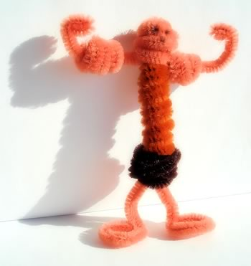
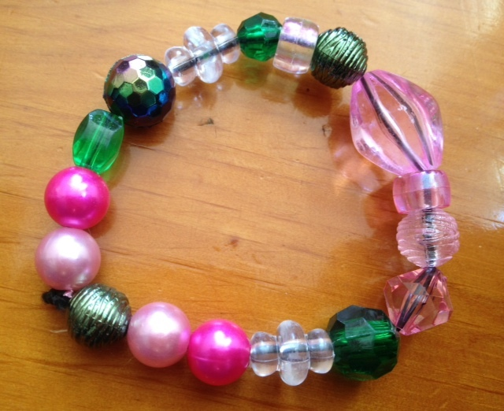
Activity Resources
Core Beliefs Handout
About Me: Sentence Completion Handout
Pipe Cleaner Artist Activity
Strengths Jewelry
Role Play
Notes:
Ashley
Pipe Cleaner: Get them to build themselves using pipeclearners. Ask them to discuss their creation.
Strengths Jewelry: Done in a lot of our groups: for each bead, ask them to identify a quality in themselves that they like. Encourage them to list physical and personality characteristics.
Role Play: Is there a situation that is quite hard for them? Practice role playing the scenario with them.

Slide 19
Accessibility Offices
University of Calgary: Student Accessibility Services http://www.ucalgary.ca/access/
Bow Valley College: Accessibility Services http://bowvalleycollege.ca/campus-services/learner-success-services/accessibility-services.html
Mount Royal University: Accessibility Services http://www.mtroyal.ca/AcademicSupport/ResourcesServices/AccessibilityServices/index.htm
Colombia College: Accessibility Services https://www.columbia.ab.ca/about-columbia/student-services/accessibility-services/
Dove Self-Esteem Project http://selfesteem.dove.ca/
Notes:
Ashley

Slide 20
References
Nkarenbi, J. (2014). Self-esteem. Retrieved from http://bit.ly/2l8tk5R
Oswalt, A. (2017). Factors Influencing The Development of Self-Esteem. Retrieved from http://bit.ly/2cVbf8n
Smith, R. (2012). Teaching Self-Advocacy to Students. York University. Retrieved from http://bit.ly/1snt8UT
Dove US Youtube Channel: https://www.youtube.com/channel/UC0uGC_EBwAxw3ljqeGjy2qw
Notes:
Ashley

