Slide 1
Sleep!
By: Shelika Joshi & Ashley Plumtree

Slide 2
The information from this presentation has been referenced from the Community Education Services presentation titled “Sleep 101” by: Dr. Laurel Korotana, R. Psyc., Neurosciences and Sleep Clinics
Dr. Celine Koryzma, R.Psyc., Pediatric Centre for Weight and Health

Slide 3
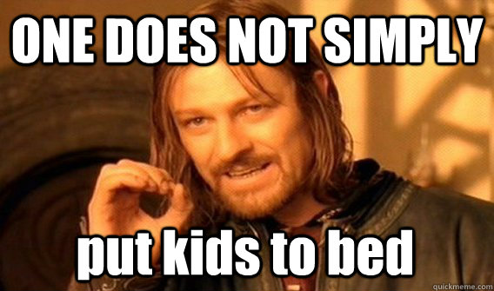
Many parents struggle with Children’s sleep issues

Slide 4
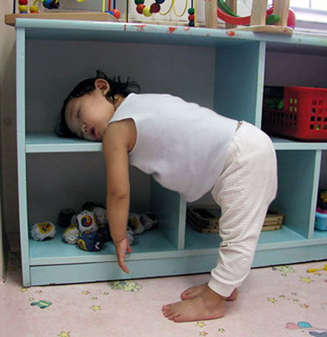
Why do we sleep??
Your brain needs sleep, so you can:
Remember what you learn
Pay attention and concentrate
Solve problems and think of new ideas
Your body needs sleep, so your:
Muscles, bones and skin can grow
Muscles, skin and other parts can fix injuries
Body can stay healthy and fight sickness

Slide 5
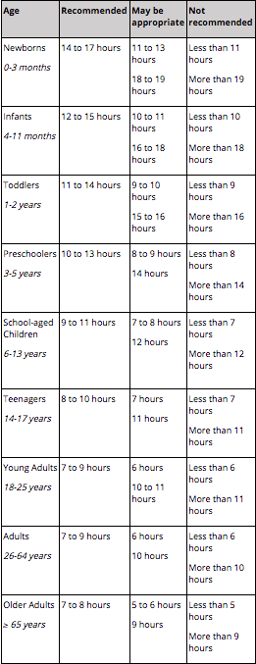
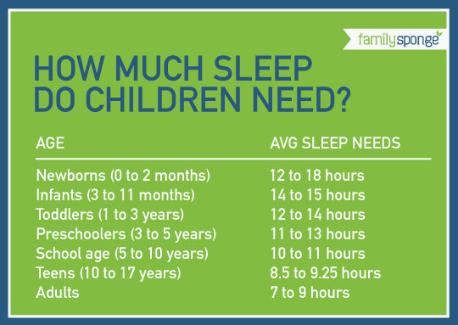
How much sleep do we need?
National Sleep Foundation has updated their recommended hours necessary for each age.

Slide 6
Signs you are not getting enough sleep
Dozing off
Moodiness
No energy for exercise
Hunger
Need to take naps during the day
Body aches
Tired or heavy eyes
Headaches

Slide 7
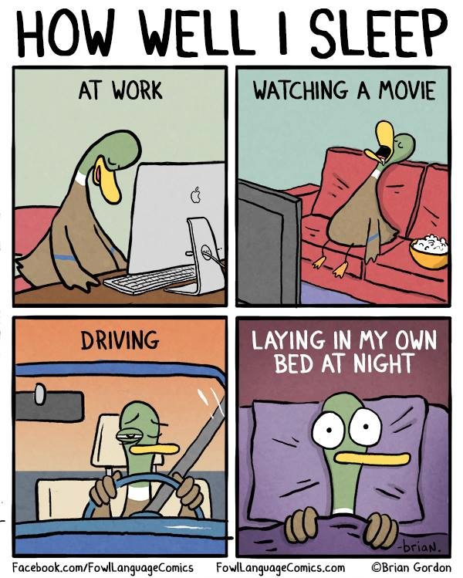
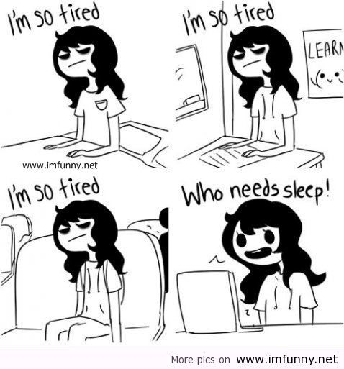
Sleep is important for parents too!

Slide 8
Signs of a parent not getting enough sleep
Sleep deprived children = Sleep deprived parents!
Similar to the signs we previously covered:
Anger, Anxiety, Irritability
Might be more willing to compromise or “give in” to things that you normally wouldn’t (tv in the bedroom, letting your child sleep in your bed, bribing, etc.)
Desperate times result in desperate measures. These measures create short term fixes

Slide 9
Sleep: The (not so basic) Basics
**Establishing healthy sleeping habits is the foundation for all techniques and suggestions covered today. **
Good sleep hygiene is the best defender against all sleeping challenges
It may seem easy, but can be very difficult to implement

Slide 10
Sleep: The (not so basic) Basics
Reduce or eliminate caffeine (ex: vitamin water, sports drinks, frappuccinos and iced capps)
No hot showers and baths right before bed
Get daily exercise, but not right before bed
Do something relaxing before bed
Limit screen time at least 60 minutes (or more) before bed
Keep a regular daily schedule
Improve sleep environment
Keep room dark, reduce noise, keep cool room temperature, remove electronics from bedroom.
If child struggles with nightmares: tv, video games, etc can exasperate this
If necessary, turn off the wifi at a certain time
Turn alarm clock around

Slide 11
Sleep: The (not so basic) Basics
It’s important to keep a regular sleep schedule even on weekends & breaks (this can be difficult).
If necessary, make small adjustments to bedtime and wake times on weekends
Explain and set the sleep time schedule with kids during the day; use age appropriate language to explain why sleep hygiene is important
BE CONSISTENT AND PERSISTENT

Slide 12
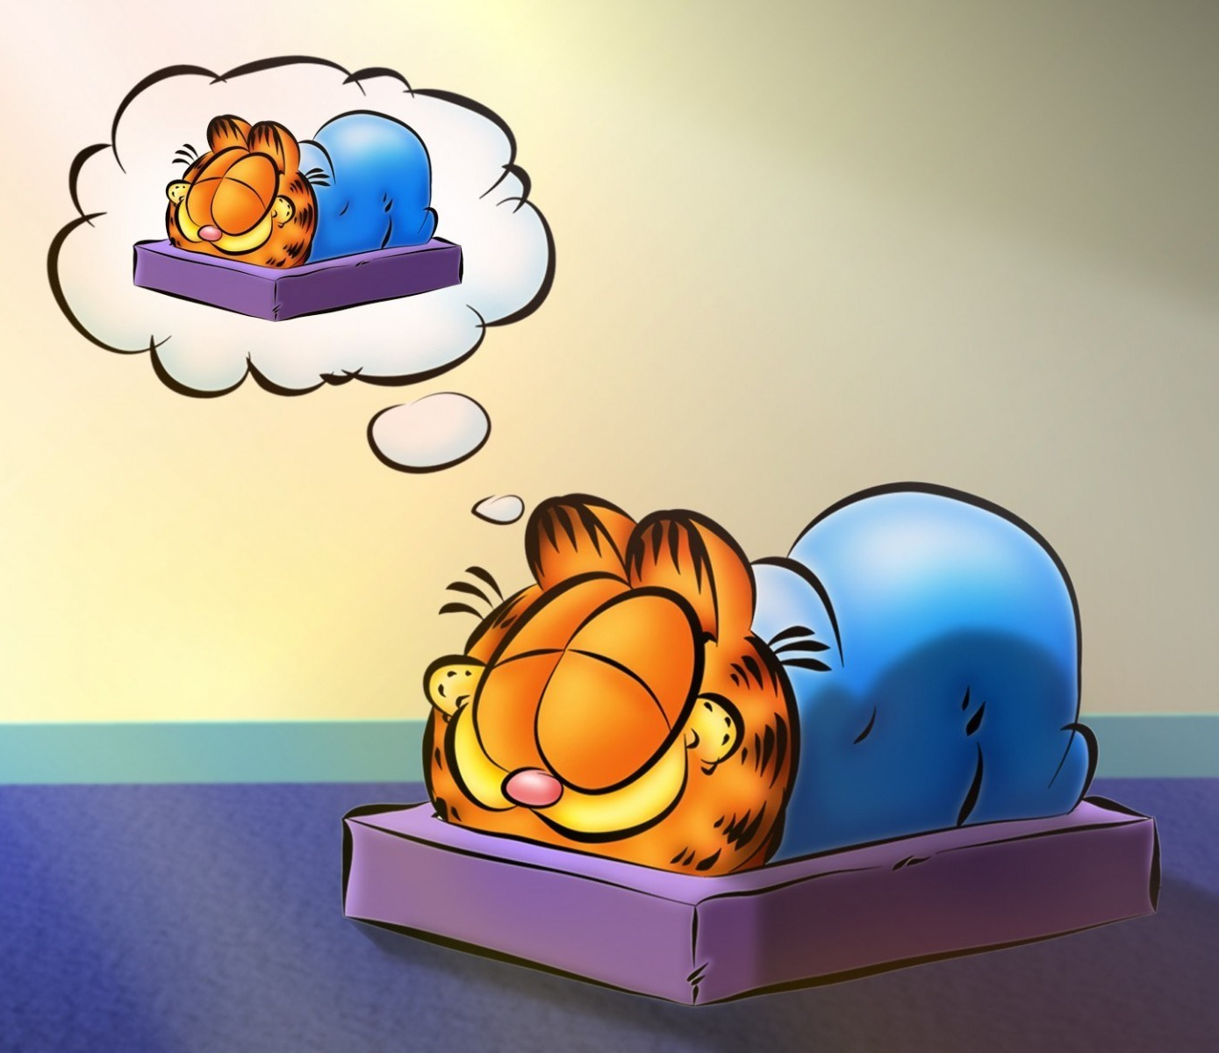
Naps!
After age 4, most developing children and adults no long require daytime naps
Naps can disrupt sleep/awake cycles

Slide 13
Identifying Sleep Problems
Which areas do the sleep problems relate to:
Falling Asleep: getting in bed, staying in bed, falling asleep
Staying Asleep: night awakenings, nightmares, disorders of arousal, early waking
Both??

Slide 14
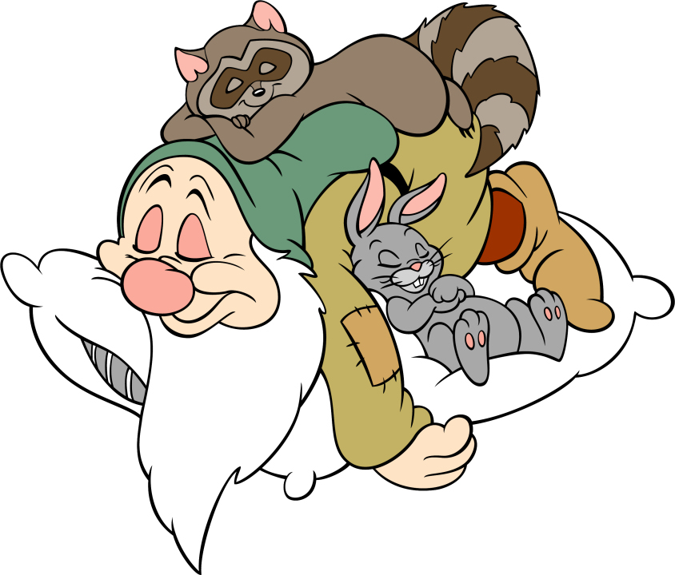
Inviting Sleep
You can’t control sleep, but there are certain things you can do to invite sleep!
Have a bedtime routine
Put electronics away early
Can include brushing your teeth, brushing your hair, using the bathroom etc
Stay calmly in bed to help invite sleep
If you can’t relax, use calming activities to help relax yourself: deep breathing, counting sheep
Bed should be used for sleeping
This way an association with built in your brain between bed and sleeping

Slide 15
Bedtime Routine
A bedtime routine:
Helps your body become calm and invites sleep
Signals your body that it’s time to prepare for sleep
Should be 30 minutes before bed
Must be consistent
Use calming activities such as brushing teeth, reading etc.

Slide 16
Staying Calm in bed
Use strategies to help relax and to stay calm in bed.
Deep breathing
Progressive Muscle Relaxation
Guided imagery

Slide 17
Emotional and Behavioural Difficulties
Bedtime Anxiety:
Bedtime is NOT an appropriate time to discuss worries
Little action can be done at that time to change the event
Can increase body dysregulation (eg. upset stomach, racing thoughts etc.)
May unintentionally encourage child to hold worries in throughout the day
Encourage the discussion and management of worries throughout the day as they arise

Slide 18
Emotional and Behavioural Difficulties
Talk about worries during a different time of the day. Consider implementing a set time for worry discussion:
“Worry Time”
“Worry Box”
Teach and encourage healthy coping strategies to battle worries.
If worry and anxiety levels are impacting the child’s quality of life, then consider seeking mental health support.
For Anxiety Resources visit:
www.AnxietyBC.com
Or
MindShift mobile app
For more coping strategies

Slide 19
Guided Imagery
Guided Imagery is like a story that guides your mind and body towards a more relaxed state
Magic Bubbles: Guided Relaxation for Kids- https://www.youtube.com/watch?v=KF52txZvUsA&t=58s
Ocean Escape: Guided Relaxation and imagery- https://www.youtube.com/watch?v=ar_W4jSzOlM

Slide 20
Emotional and Behavioural Difficulties
Leaving the bedroom after bedtime:
Strategy: “Bedtime pass system”
3 passes: can use them OR turn them in the next morning for a small reward (sticker, etc.). Once you run out, that’s it. Implementation gauged to your situation. Have reasonable expectations
Calling for parents after bedtime:
Strategy: “Parental checking system”
Don’t respond to the calls. Check in increments: every 5 minutes, then 7, then 10, 12, 15, etc. Quick and neutral check in
If the child leaves the room, reduce the interactions

Slide 21
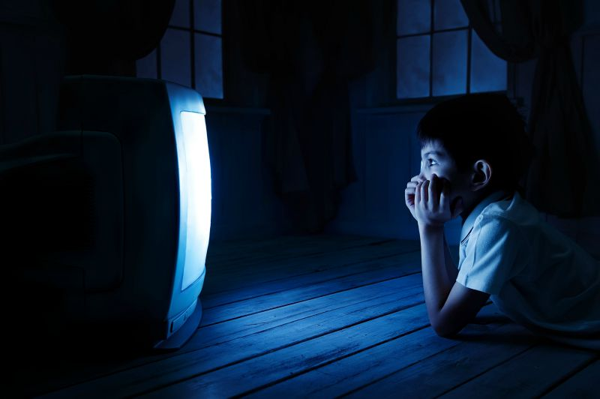
The bed is for sleeping!
Try to train your brain to learn that being in bed = falling asleep!
Avoid non-sleep activities in bed such as:
Homework
Playing
Video games
Television

Slide 22
The bed is for sleeping!
If in bed for more than 30mins and can’t fall asleep, consider allowing limited activities out of bed:
Read, color, something relaxing
Too much time in bed, struggling to fall asleep can create an association between bed and frustration.
Allow sleep pressure to build: maybe going to be too early?

Slide 23
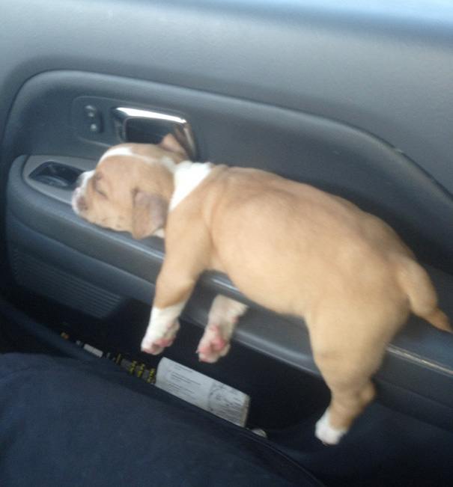
Building Sleep Pressure
Consider adjusting bedtime to a time when the child naturally falls asleep (within reason).
If this is successful, make the time earlier by 10-15 minutes. Allow this routine to work, then reduce again, until desired time is reached
Keep wake time consistent
Avoid daytime napping

Slide 24
Night Awakenings
Waking up a few times during the night is NORMAL
Waking up and not being able to fall back asleep is a problem
Does anyone here wake up frequently through the night?
Do they need something special in their room so that they can fall asleep (Teddy bear, night light, etc.)?

Slide 25
Night Awakenings
Most people go through 4-6 sleep cycles a night, thats potential for 4-6 awakenings each night!
Problem occurs when child is unable to fall back asleep on their own
Risk Factors:
Overtired
Negative Sleep associations:
May require specific sleep environments:
Eg: Parent in the room, being rocked to sleep, tv on, radio on

Slide 26
Night Awakenings
Change any negative sleep associations:
Help child fall asleep on their own (self-soothe)
Leave the child when they are drowsy but still awake
This is the same for other stimuli, eg. tv, radio, turn off before the child falls asleep
Can use security objects instead (stuffed animal, blanket etc)
Strategy: Moving chair technique:
Sit in a chair close to the bed, start to move away at a pace that is effective for your family

Slide 27
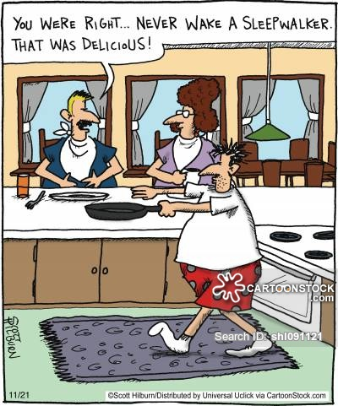
Sleepwalking and sleep terrors
How to reduce the risk:
Good sleep hygiene
Getting the required amount of sleep
Reducing anxiety/stressors
How to manage:
Ensure safety
Reduce parental intervention: just encourage bed
If very prominent and getting dangerous: schedule awakenings, but see a doctor first

Slide 28
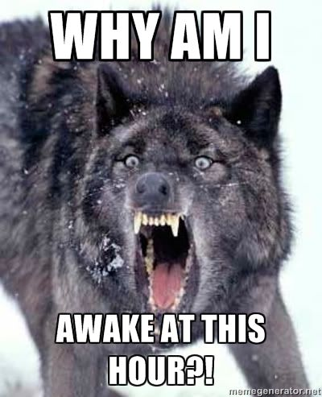
Early Wakings
Problem of not enough sleep or the timing of sleep?
How to manage:
Find appropriate time for sleep
Good sleep hygiene
Avoid being overtired
Avoid negative sleep associations

Slide 29
Tips!
All of this can be difficult!
Do your best!
Try not to punish or reward based on the amount of sleep the child gets. This isn’t always controllable. Instead focus on rewarding the effort of following the routine, rules, and sleep structure!

Slide 30
Funny Video
Mr Bean’s Holiday : https://www.youtube.com/watch?v=cA-laLpcLIw

Slide 31
Questions?
Consider sleep like a sleepbelt. You don’t move forward without it.

Slide 32
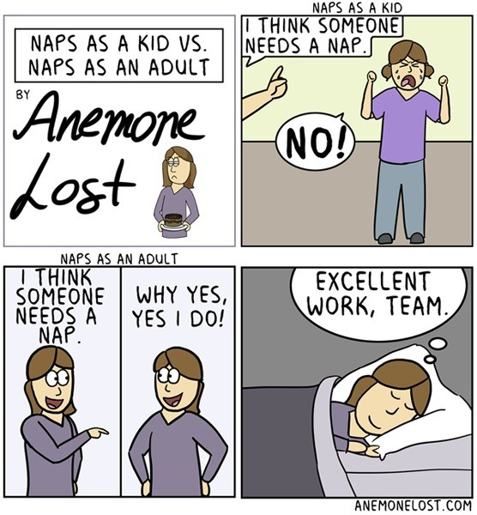
More Resources
Community Education Services:
http://fcrc.albertahealthservices.ca/ces/
National Sleep Foundation:
https://sleepfoundation.org
Sleep 101 Presentation Referenced:
http://fcrc.albertahealthservices.ca/ces/sessions/files/2017-01-13-14-39-06-Jan-16-Sleep-101---handoutCompatibility-Mode.pdf

